Slide 1



Slide 2
Red Laser Steel Cobra Danger Unicorns Presents: Lack of genetic isolation by distance, similar genetic structuring but different demographic histories in a fig pollinating wasp mutualism By: ENWEI TIAN, JOHN D. NASON, CARLOS A. MACHADO, LINNA ZHENG, HUI YU and FINN KJELLBERG
Jose Lopez, Ashley Paulsen, Lyle Sisson, Jacob Zobrist

Slide 3
Why did we choose this paper?
This paper was chosen because Jose Lopez is a member of Dr. John Nason's group
Gives a shout out to ISU Professor
Thought that would allow us to recreate the code more readily
Ask for raw data
Ask for help

Slide 4
BD also take into account the geographic distance that we do not have.

Slide 5
Analysis and Formatting in R
We had to do a lot of data formatting and I ended up doing most of this in R
The data was given as an microsatellite data in an excel workbook, in what we learned is GenAlEx format, and haplotypes mitochondrial DNA sequences in a text file
These files we not very compatible with most of our software
They also used the Genepop package in R

Slide 6
Formatting mtDNA into FASTA
We needed the mtDNA Haplotype information in FASTA format for other programs
The original file contained location information and was poorly laid out
I used R to selectively delete the unnecessary information and to write the resulting data frame into a fasta text file

Slide 7
Formatting microsatellite into genepop format
Genepop has very specific format requirements, that are completely different from the given GenAlEx format
Had to trim unnecessary info
The given data had two columns per locus, genepop requires one column per locus with 4 characters. Any space must be filled with zeros
The data had to be converted to strings, checked for length, and then concatenated into the right loci
Plus other details

Slide 8
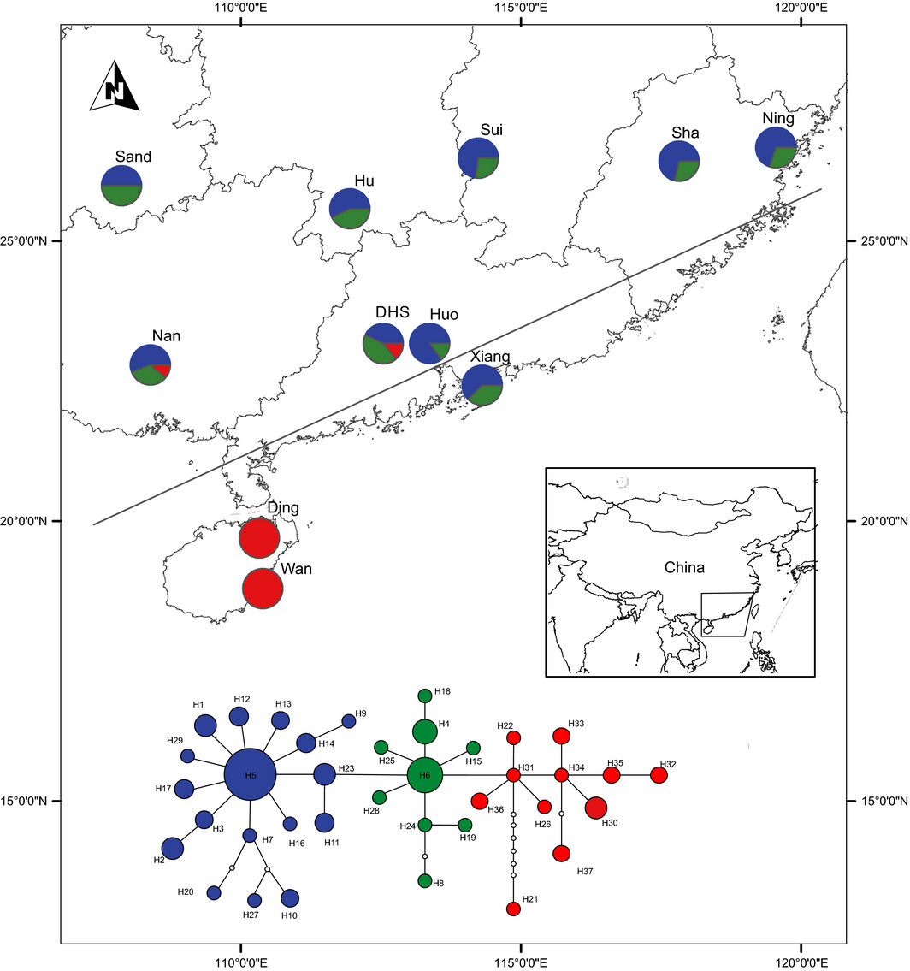
Sampling sites and mitochondrial DNA (mtDNA) nested haplotype clade distribution for Valisia javana. The grey line represents the rotated measure of latitude implemented following Yu & Nason (2013).

Slide 9
GenAlEx Format

Slide 10
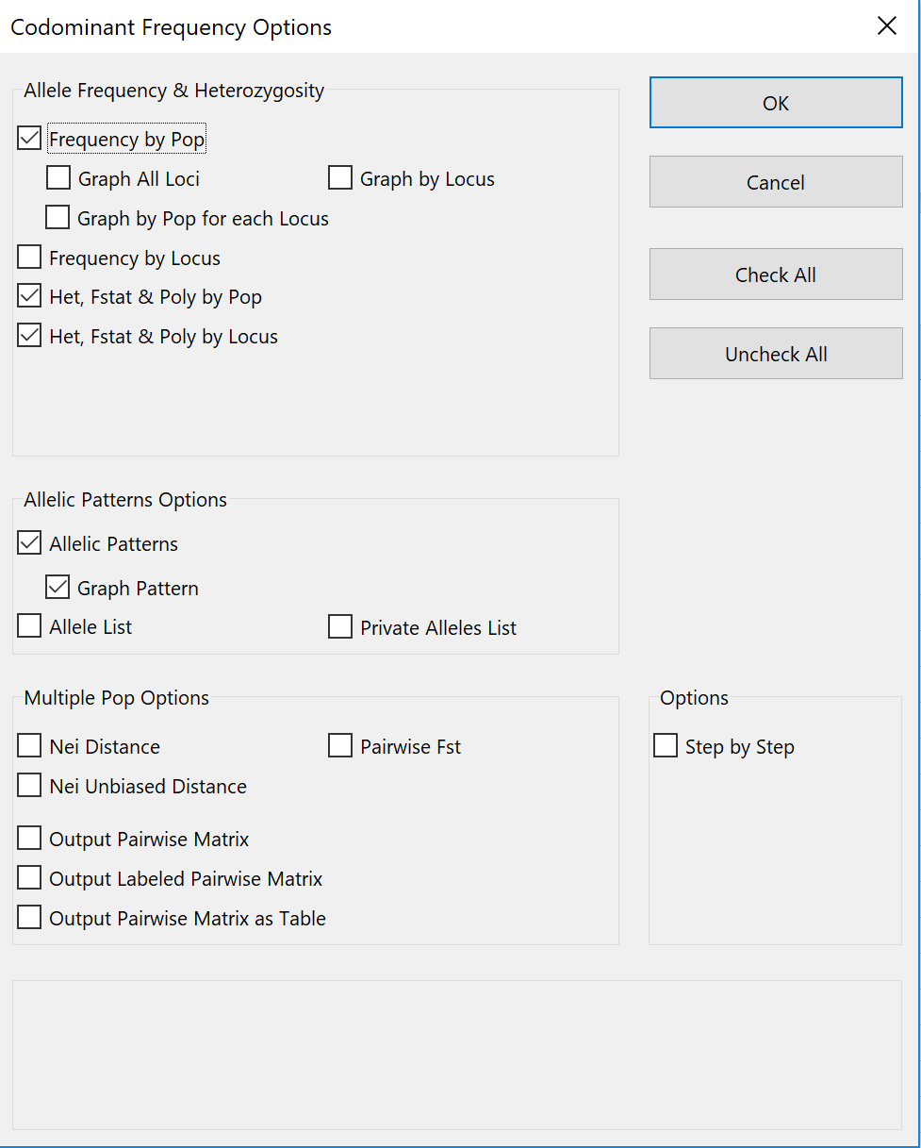
Heterozygosity, F-statistics, and Allelic Patterns

Slide 11
Mean Allelic Patterns Across Populations
Mean values
Population | Ning | Sha | Sui | Xiang | Huo | DHS | Hu | Sand | Nan | Ding | Wan
Na | 5.333 | 5.556 | 5.667 | 5.111 | 6.444 | 6.889 | 6.667 | 7.111 | 6.667 | 8.222 | 5.222
Na Freq. >= 5% | 4.111 | 3.667 | 4.111 | 3.444 | 4.111 | 4.000 | 4.444 | 5.111 | 4.333 | 5.778 | 5.222
Ne | 3.067 | 2.877 | 2.982 | 2.507 | 3.557 | 3.995 | 3.617 | 4.193 | 3.057 | 5.173 | 3.124
I | 1.111 | 1.131 | 1.151 | 1.019 | 1.360 | 1.301 | 1.294 | 1.487 | 1.242 | 1.537 | 1.140
No. Private Alleles | 0.000 | 0.111 | 0.000 | 0.111 | 0.444 | 0.556 | 0.444 | 0.333 | 0.556 | 1.667 | 0.222
No. LComm Alleles (<=25%) | 0.111 | 0.444 | 0.444 | 0.222 | 0.889 | 0.333 | 0.556 | 0.889 | 0.444 | 1.111 | 1.222
No. LComm Alleles (<=50%) | 1.556 | 1.889 | 1.556 | 1.333 | 2.111 | 1.778 | 2.333 | 2.556 | 2.111 | 2.556 | 2.444
He | 0.528 | 0.562 | 0.551 | 0.494 | 0.632 | 0.589 | 0.591 | 0.683 | 0.557 | 0.651 | 0.539
uHe | 0.541 | 0.572 | 0.565 | 0.510 | 0.654 | 0.601 | 0.606 | 0.703 | 0.572 | 0.669 | 0.568
Standard Error (SE) values
Population | Ning | Sha | Sui | Xiang | Huo | DHS | Hu | Sand | Nan | Ding | Wan
Na | 0.986 | 1.132 | 1.155 | 0.857 | 0.959 | 1.419 | 1.344 | 0.964 | 1.280 | 1.942 | 1.038
Na Freq. >= 5% | 0.676 | 0.577 | 0.512 | 0.580 | 0.484 | 0.745 | 0.709 | 0.772 | 0.833 | 0.983 | 1.038
Ne | 0.624 | 0.465 | 0.609 | 0.436 | 0.690 | 1.169 | 0.949 | 0.801 | 0.495 | 1.383 | 0.595
I | 0.223 | 0.192 | 0.201 | 0.186 | 0.177 | 0.244 | 0.229 | 0.177 | 0.234 | 0.281 | 0.240
No. Private Alleles | 0.000 | 0.111 | 0.000 | 0.111 | 0.242 | 0.444 | 0.242 | 0.236 | 0.377 | 0.726 | 0.222
No. LComm Alleles (<=25%) | 0.111 | 0.338 | 0.176 | 0.147 | 0.351 | 0.167 | 0.338 | 0.200 | 0.242 | 0.754 | 0.662
No. LComm Alleles (<=50%) | 0.556 | 0.655 | 0.503 | 0.577 | 0.539 | 0.741 | 0.799 | 0.626 | 0.754 | 1.002 | 0.930
He | 0.100 | 0.082 | 0.083 | 0.082 | 0.069 | 0.087 | 0.087 | 0.056 | 0.099 | 0.092 | 0.099
uHe | 0.102 | 0.083 | 0.085 | 0.084 | 0.072 | 0.089 | 0.089 | 0.057 | 0.102 | 0.094 | 0.104

Slide 12
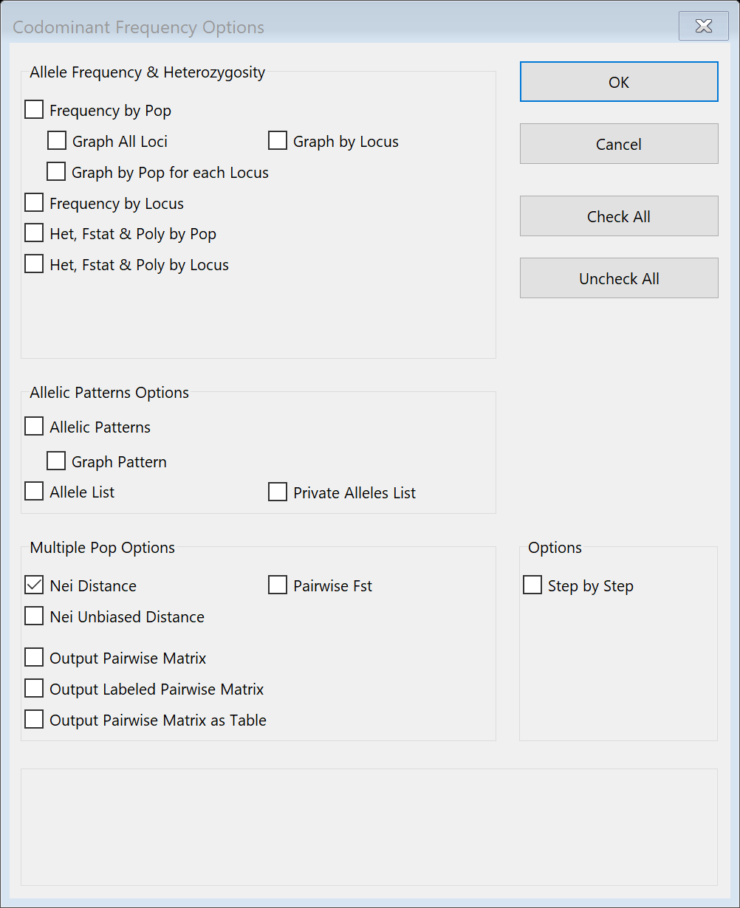
Nei’s Genetic Distance D.
While FST is perhaps the most widely used measure of genetic differentiation among
populations, another frequently used estimate of the genetic difference among populations

Slide 13
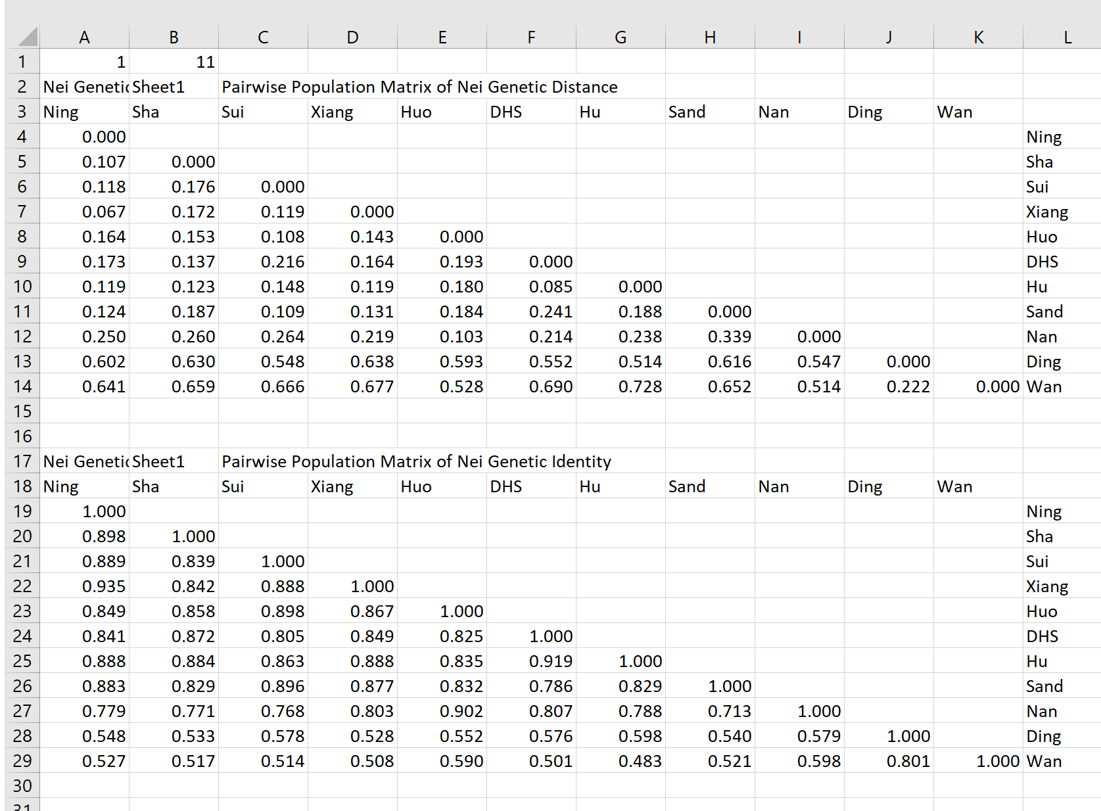

Slide 14

Pairwise Fst and Nei Genetic Distances

Slide 15
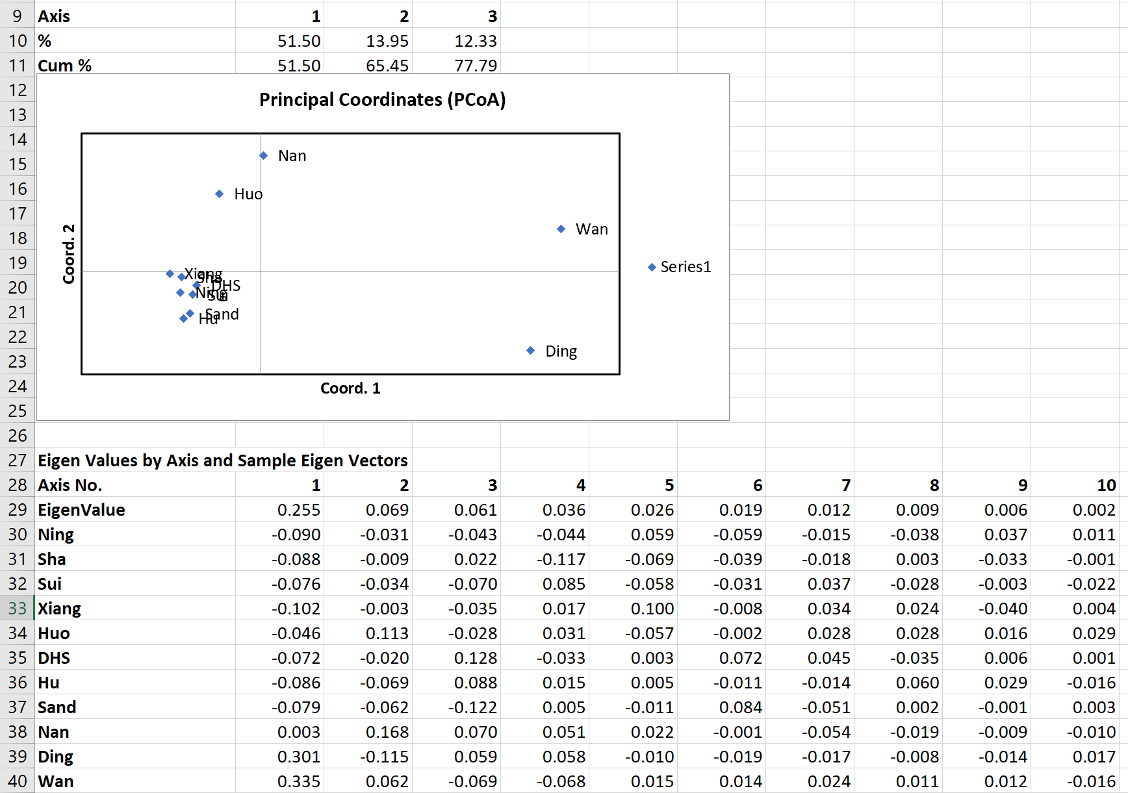
PCoA test from NeiP

Slide 16
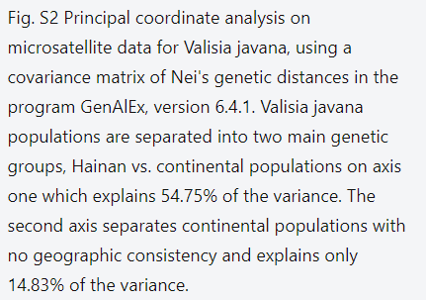
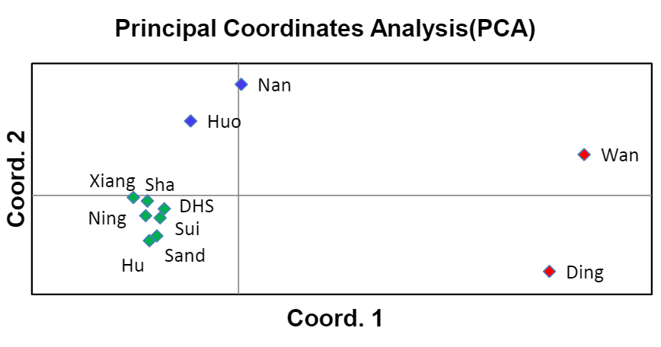

Slide 17
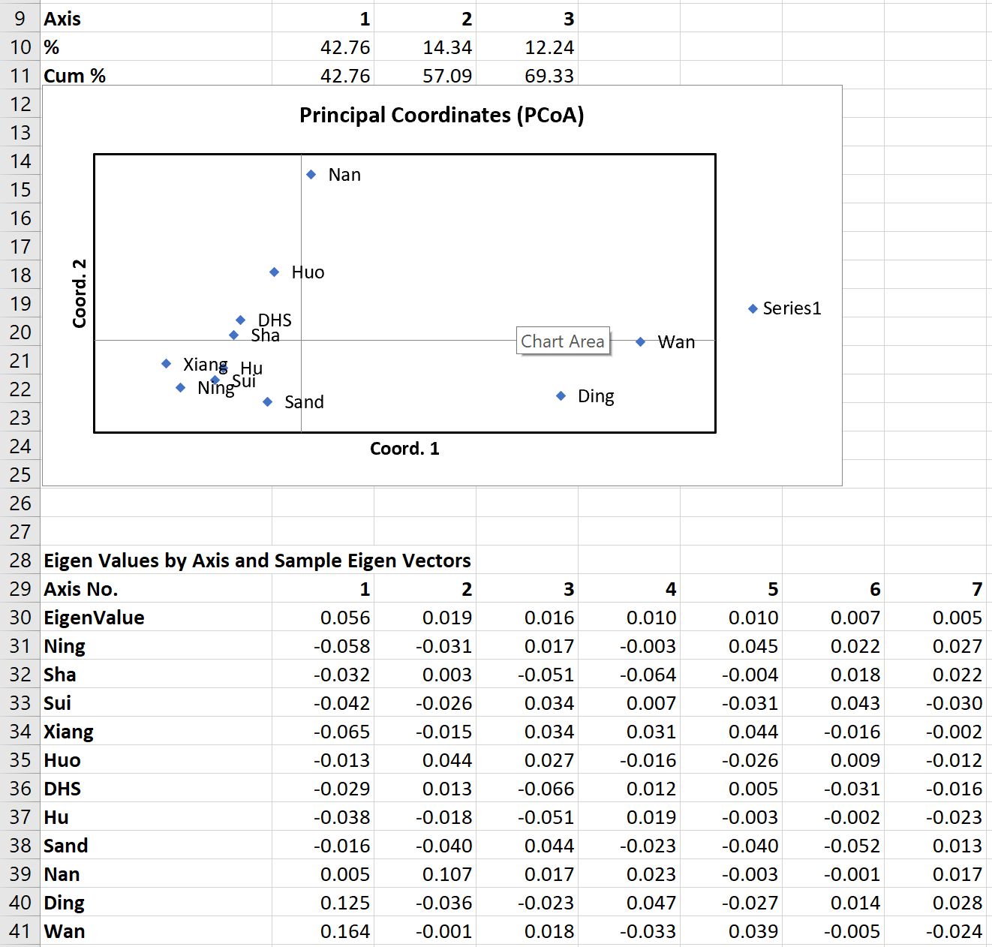
PCoA from FstP

Slide 18
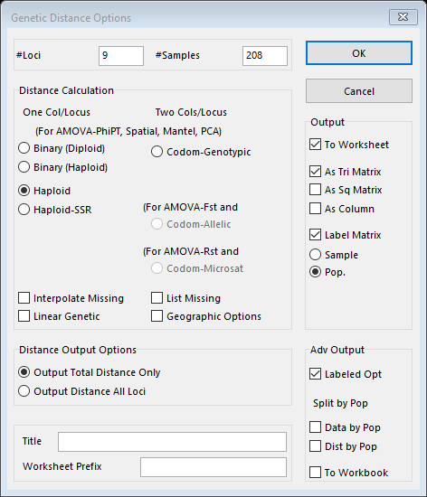
Calculating Haploid Distance

Slide 19
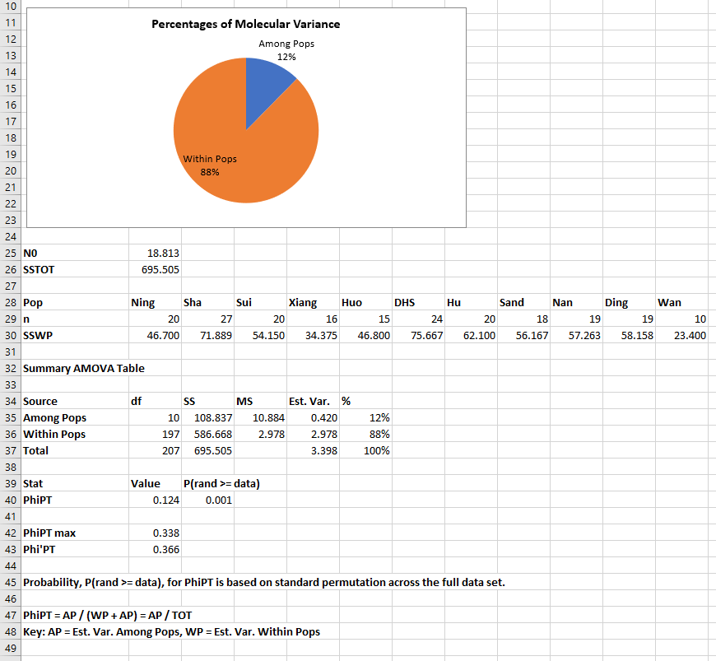
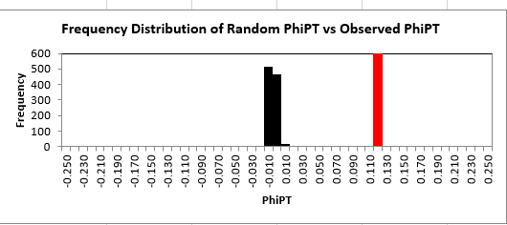
AMOVA Test

Slide 20
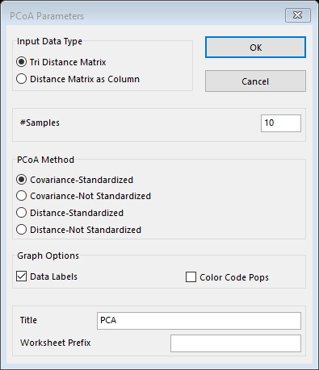
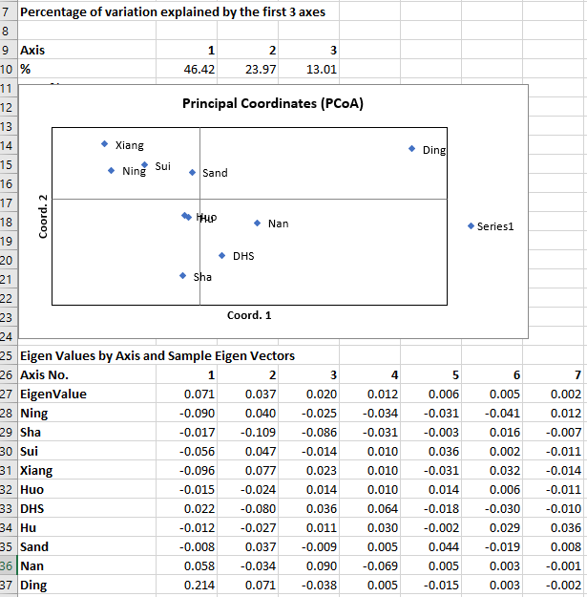
PCoA on PhiPTP

Slide 21
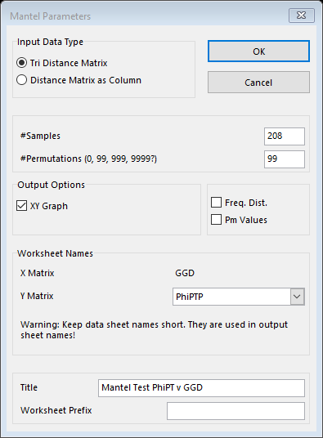
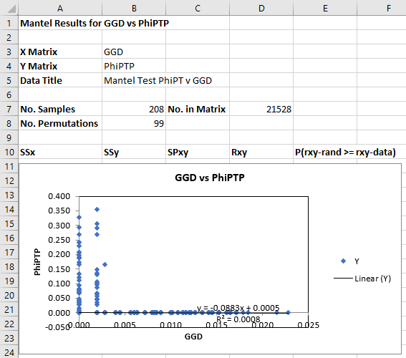
Mantel Tests for Isolation-by-Distance

Slide 22
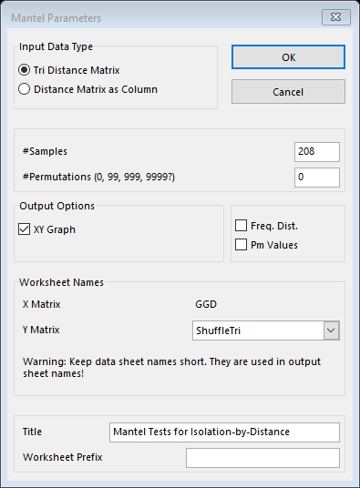
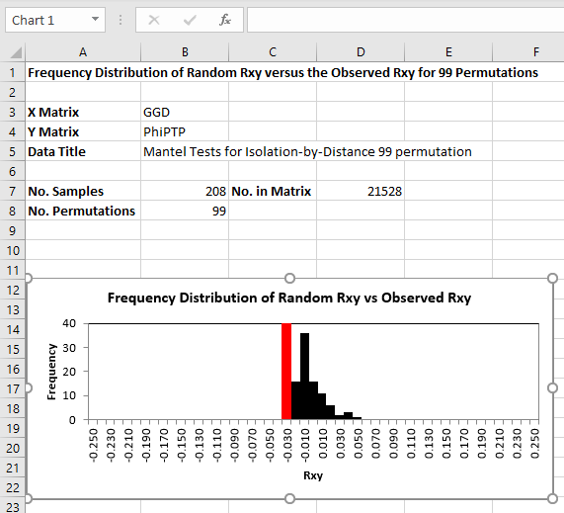
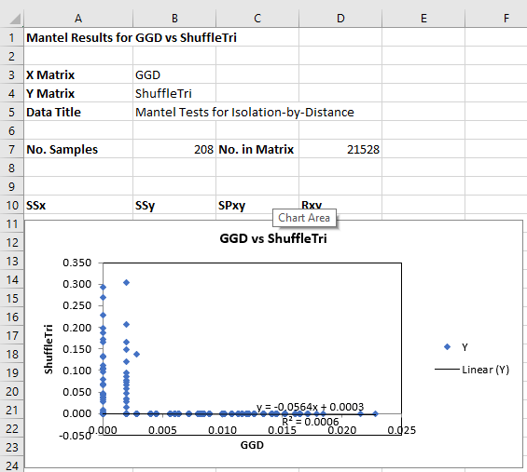
Mantel Tests for Isolation-by-Distance

Slide 23
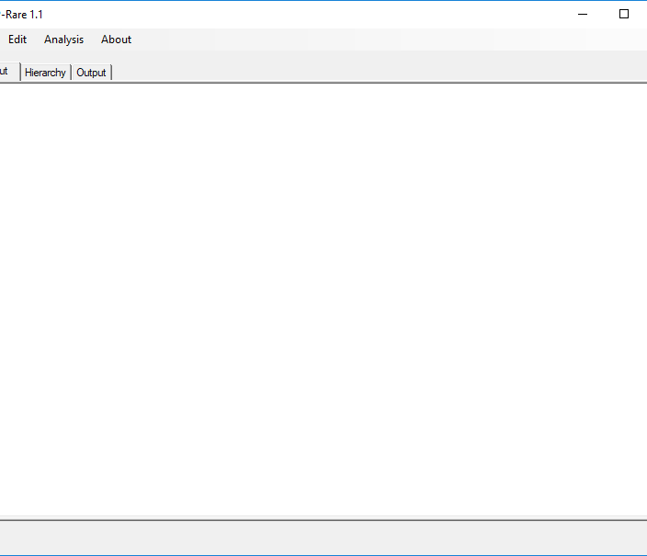
PAR and AR

Slide 24
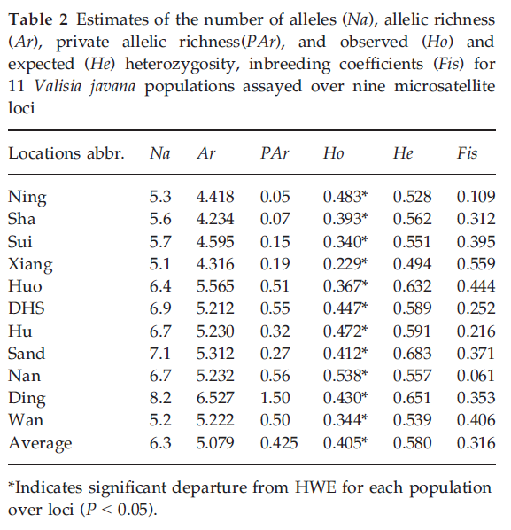

Slide 25
Table 2
Ours
Theirs
Locations | Na | Ar | PAr | Ho | He | Fis
Ning | 5.333333 | 4.42 | 0.05 | 0.483333 | 0.5275 | 0.102166
Sha | 5.555556 | 4.23 | 0.07 | 0.393416 | 0.561581 | 0.323446
Sui | 5.666667 | 4.59 | 0.12 | 0.339734 | 0.551027 | 0.35625
Xiang | 5.111111 | 4.32 | 0.19 | 0.229167 | 0.493924 | 0.529446
Huo | 6.444444 | 5.56 | 0.4 | 0.366667 | 0.632048 | 0.440515
DHS | 6.888889 | 5.21 | 0.53 | 0.44686 | 0.588674 | 0.234764
Hu | 6.666667 | 5.23 | 0.32 | 0.472222 | 0.590734 | 0.212705
Sand | 7.111111 | 5.86 | 0.4 | 0.412128 | 0.683157 | 0.417698
Nan | 6.666667 | 5.23 | 0.47 | 0.538012 | 0.556941 | 0.020912
Ding | 8.222222 | 6.53 | 1.5 | 0.429825 | 0.651008 | 0.390561
Wan | 5.222222 | 5.22 | 0.5 | 0.344444 | 0.539444 | 0.320547
Average | 6.262626 | 5.127273 | 0.413636 | 0.405073 | 0.57964 | 0.304455
Locations abbr. | Na | Ar | PAr | Ho | He | Fis
Ning | 5.3 | 4.418 | 0.05 | 0.483a | 0.528 | 0.109
Sha | 5.6 | 4.234 | 0.07 | 0.393a | 0.562 | 0.312
Sui | 5.7 | 4.595 | 0.15 | 0.340a | 0.551 | 0.395
Xiang | 5.1 | 4.316 | 0.19 | 0.229a | 0.494 | 0.559
Huo | 6.4 | 5.565 | 0.51 | 0.367a | 0.632 | 0.444
DHS | 6.9 | 5.212 | 0.55 | 0.447a | 0.589 | 0.252
Hu | 6.7 | 5.230 | 0.32 | 0.472a | 0.591 | 0.216
Sand | 7.1 | 5.312 | 0.27 | 0.412a | 0.683 | 0.371
Nan | 6.7 | 5.232 | 0.56 | 0.538a | 0.557 | 0.061
Ding | 8.2 | 6.527 | 1.50 | 0.430a | 0.651 | 0.353
Wan | 5.2 | 5.222 | 0.50 | 0.344a | 0.539 | 0.406
Average | 6.3 | 5.079 | 0.425 | 0.405a | 0.580 | 0.316

Slide 26
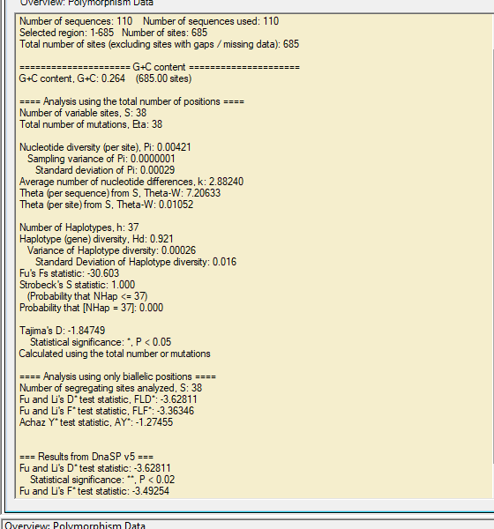
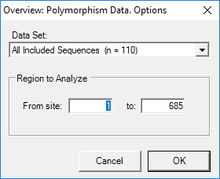
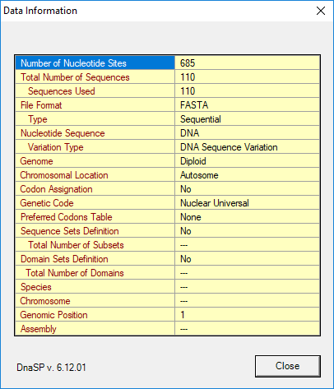
DNASP

Slide 27
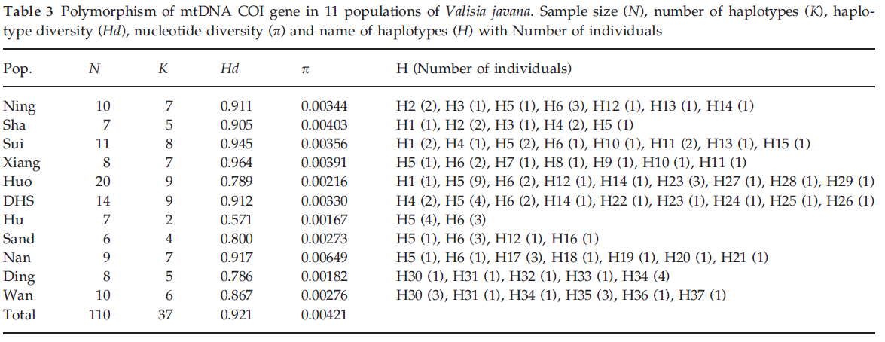

Slide 28
Pop. | N | K | Hd | p
Ning | 10 | 7 | 0.911 | 0.00344
Sha | 7 | 5 | 0.905 | 0.00403
Sui | 11 | 8 | 0.945 | 0.00356
Xiang | 8 | 7 | 0.964 | 0.00391
Huo | 20 | 9 | 0.789 | 0.00216
DHS | 14 | 9 | 0.912 | 0.0033
Hu | 7 | 2 | 0.571 | 0.00167
Sand | 6 | 4 | 0.8 | 0.00273
Nan | 9 | 7 | 0.917 | 0.00649
Ding | 8 | 5 | 0.786 | 0.00182
Wan | 10 | 6 | 0.867 | 0.00276

Slide 29
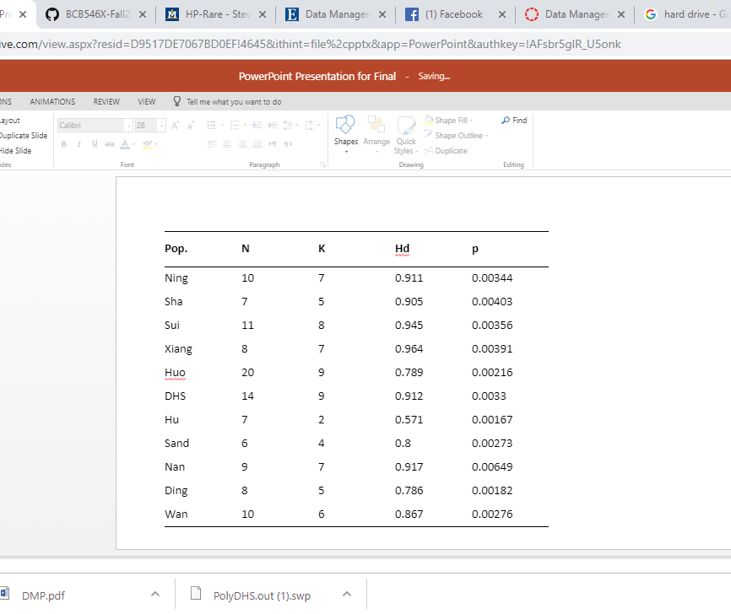
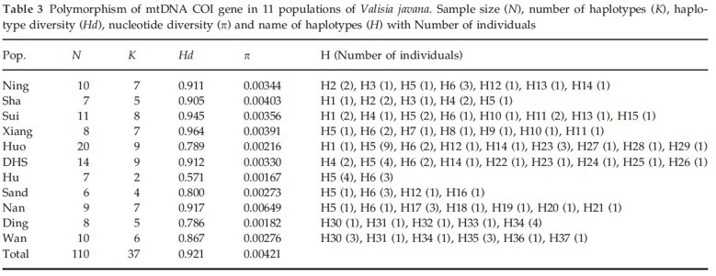
Table 3

Slide 30
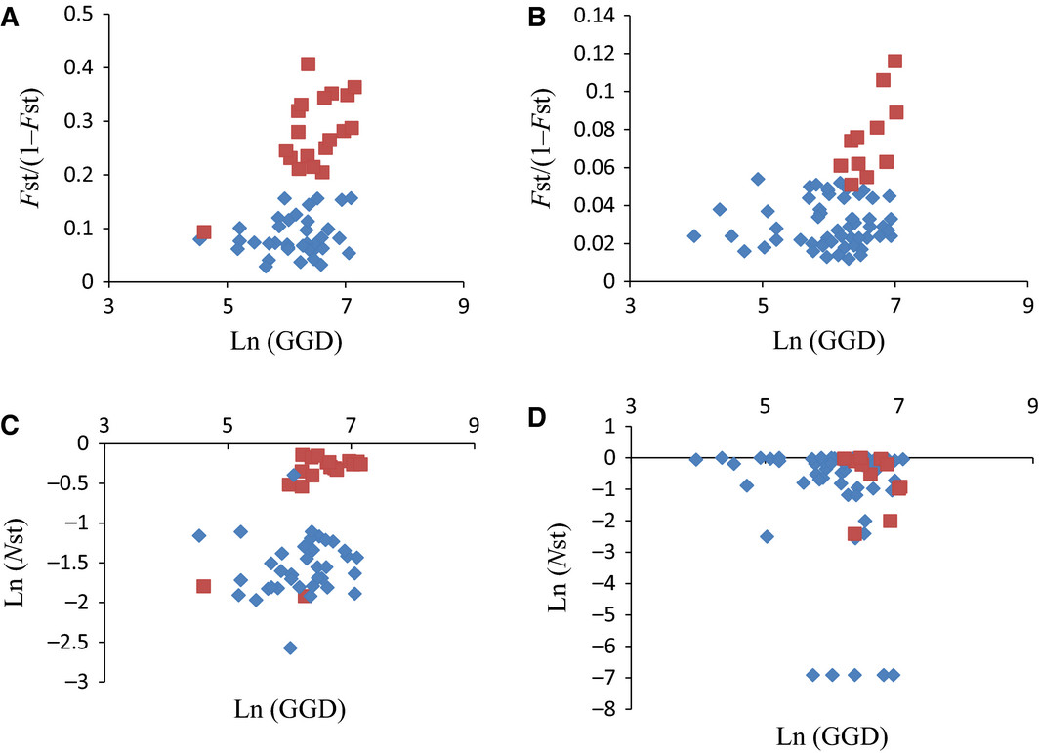
Figure 2. Pairwise genetic differentiation among populations according to geographic distance in Valisia javana (A, C) and Ficus hirta (B, D) including all populations (red squares: comparisons involving the Hainan populations; blue diamonds: comparisons between pairs of continental populations) for microsatellite data A, B and cytoplasmic DNA sequence (C: mt DNA for V. javana and D: cpDNA for F. hirta). (A) Pairwise genetic distance Fst/(1- FST) according to the natural logarithm of geographic distance (GGD; km) in V. javana. (B) Pairwise genetic distance FST/(1-FST) according to the natural logarithm of geographic distance (km) of F. hirta. (C) Logarithm of genetic distance (Nst) according to the natural logarithm of geographic distance (km) of V. javana. (D) Logarithm transform of genetic distance (NST) according to the natural logarithm of geographic distance (km) in F. hirta.

Slide 31
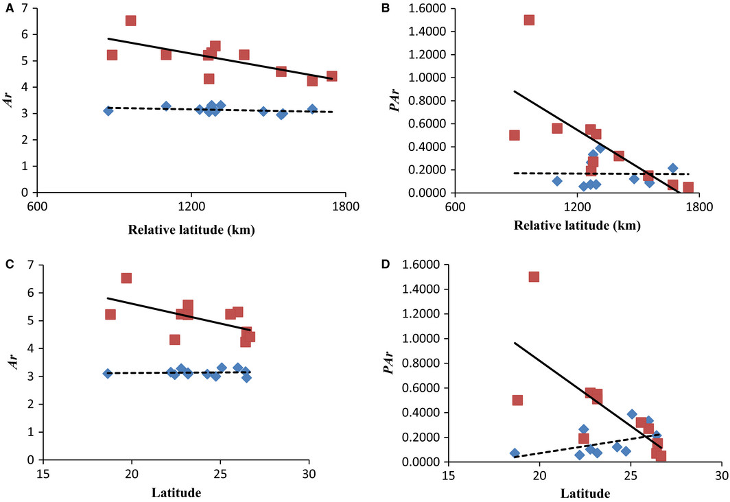
Decreasing microsatellite diversity with relative latitude in Valisia javana (red squares) but not in Ficus hirta (blue diamonds), including all populations. For V. javana, both allelic richness (Ar) and private allelic richness (PAr) decreased significantly with latitude. (A) Ar with relative latitude; (B) PAr with relative latitude; (C) Ar with latitude; (D) PAr with relative latitude.

Slide 32
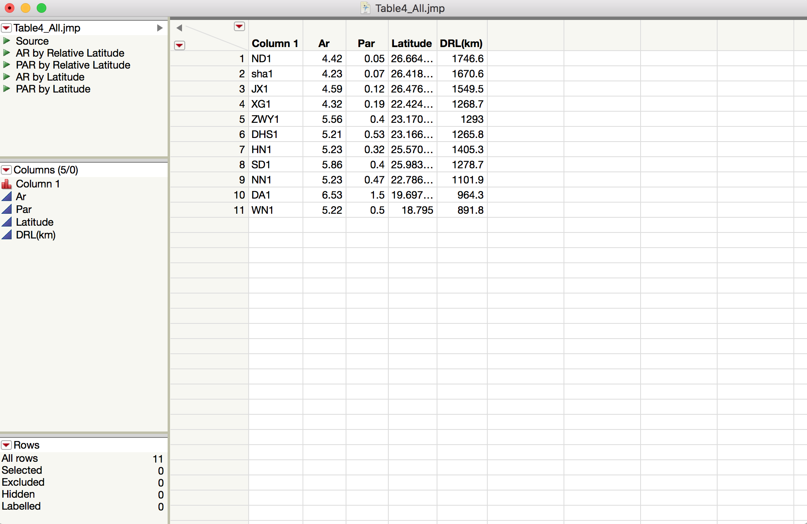
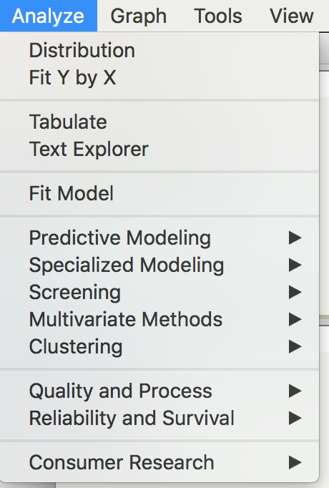
JMP

Slide 33
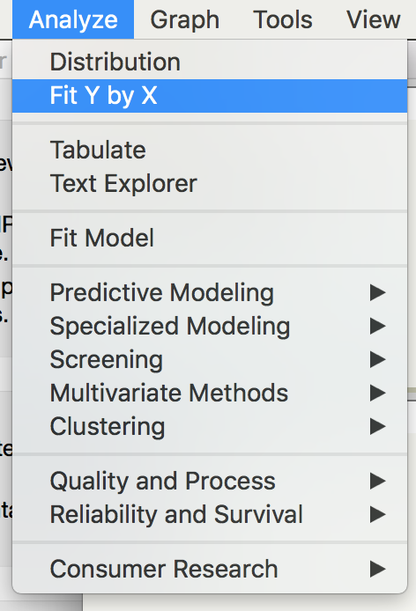
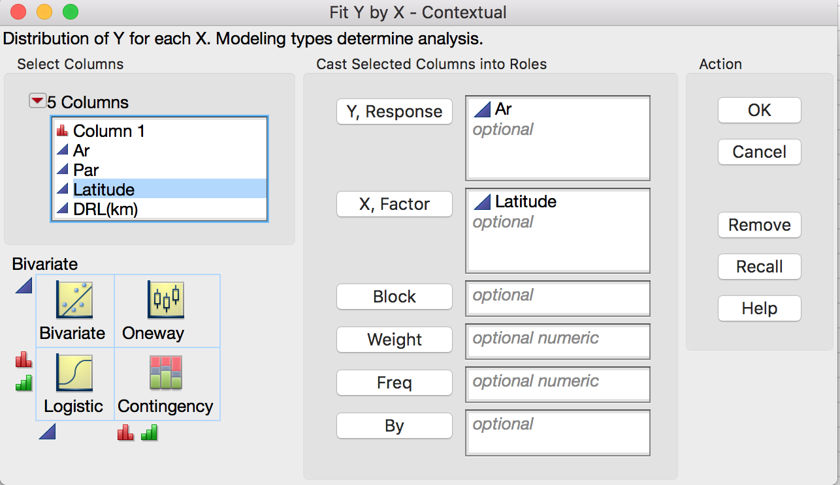
JMP

Slide 34
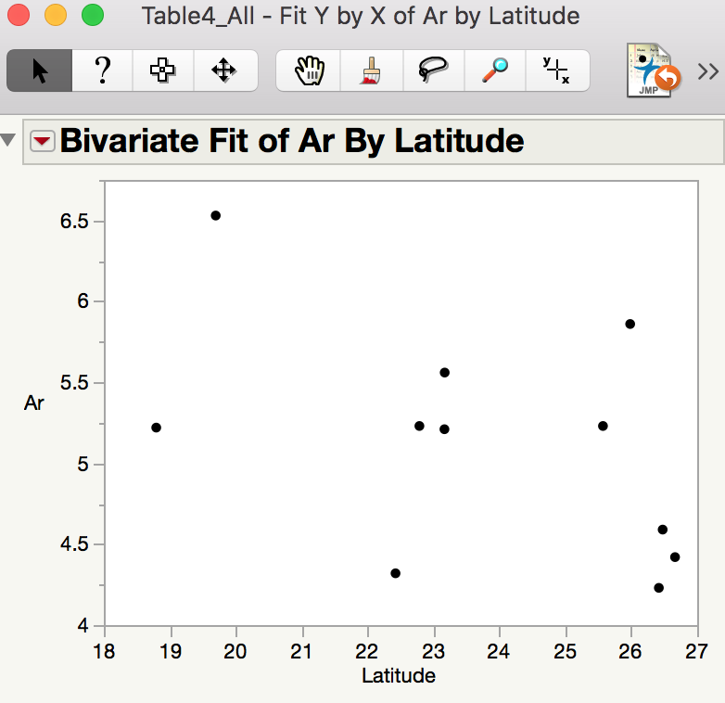
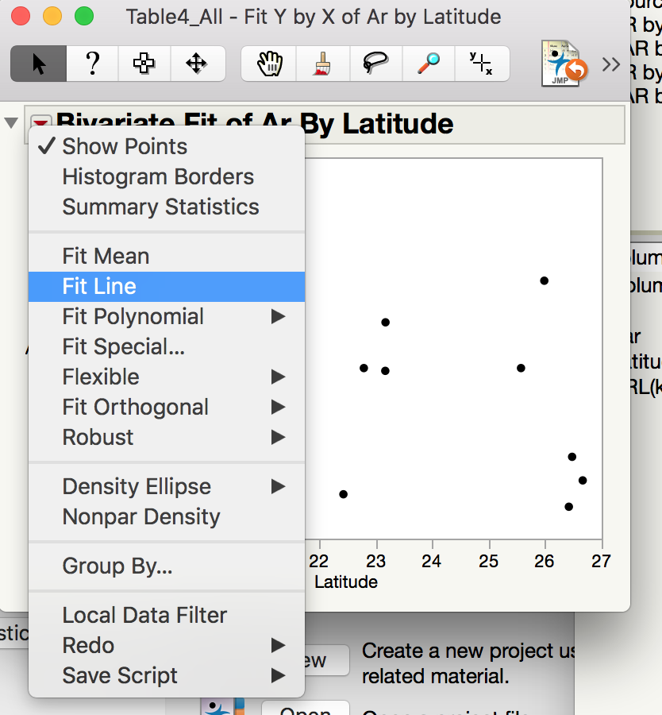
JMP

Slide 35
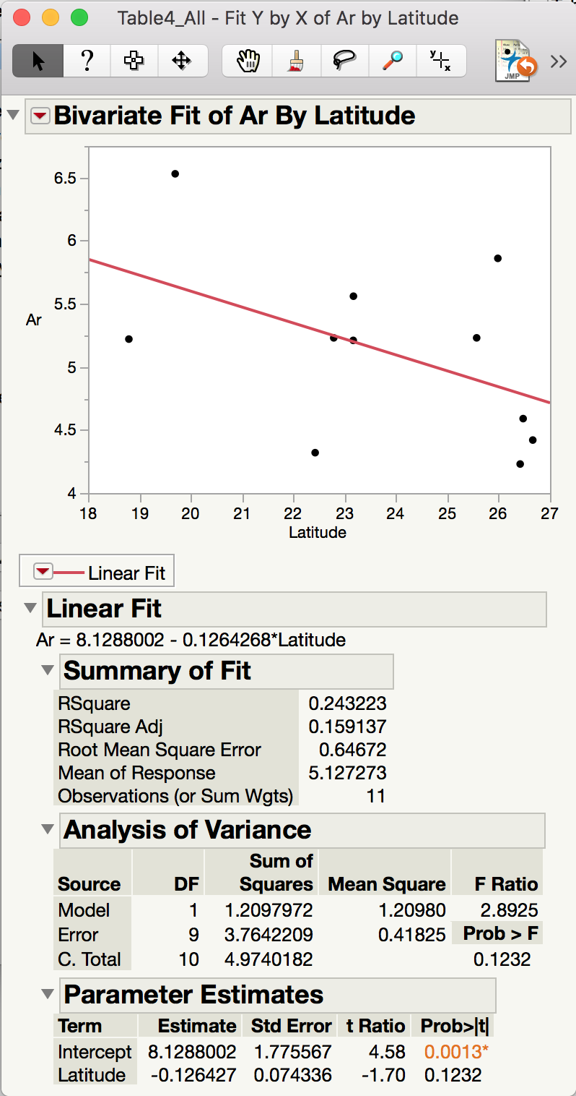
JMP

Slide 36
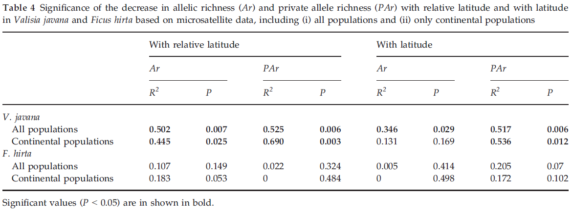
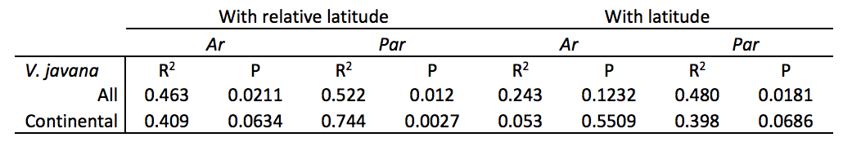

Slide 37
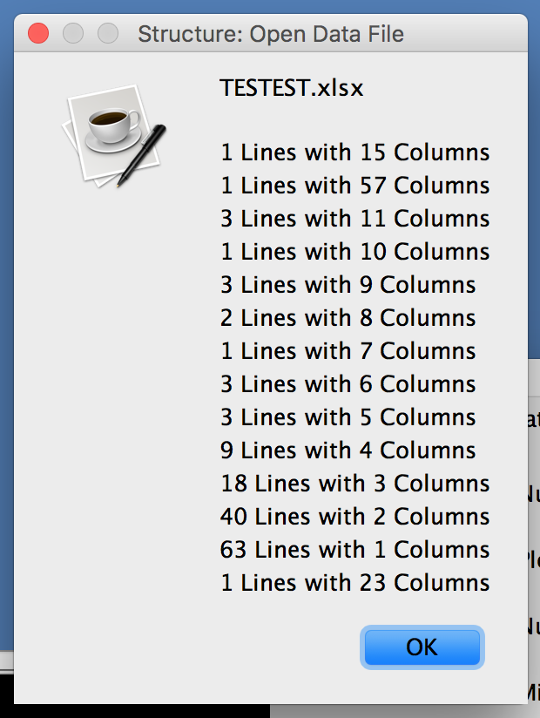

STRUCTURE

Slide 38
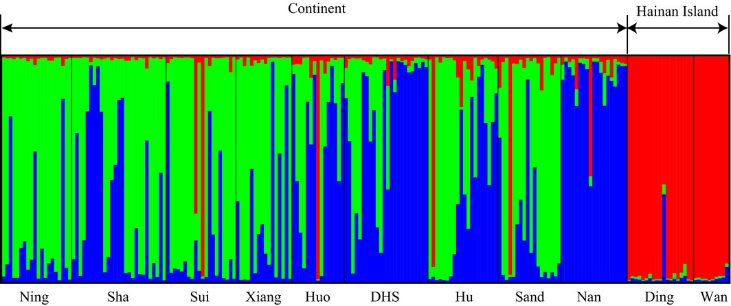
The structure analysis of Valisia javana nuclear microsatellite genotypes for K = 3 clusters separates Hainan individuals. Black lines separate individuals of different populations. Population names are labelled under the figure, with their regional affiliations (continent and Hainan Island) above it.

Slide 39
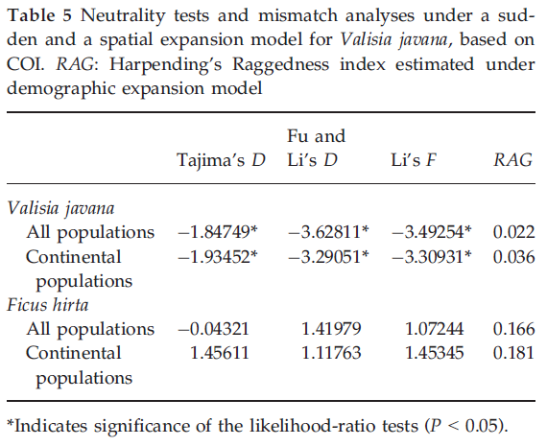

Slide 40
How easy was this Data to Reproduce?

